Slide 1
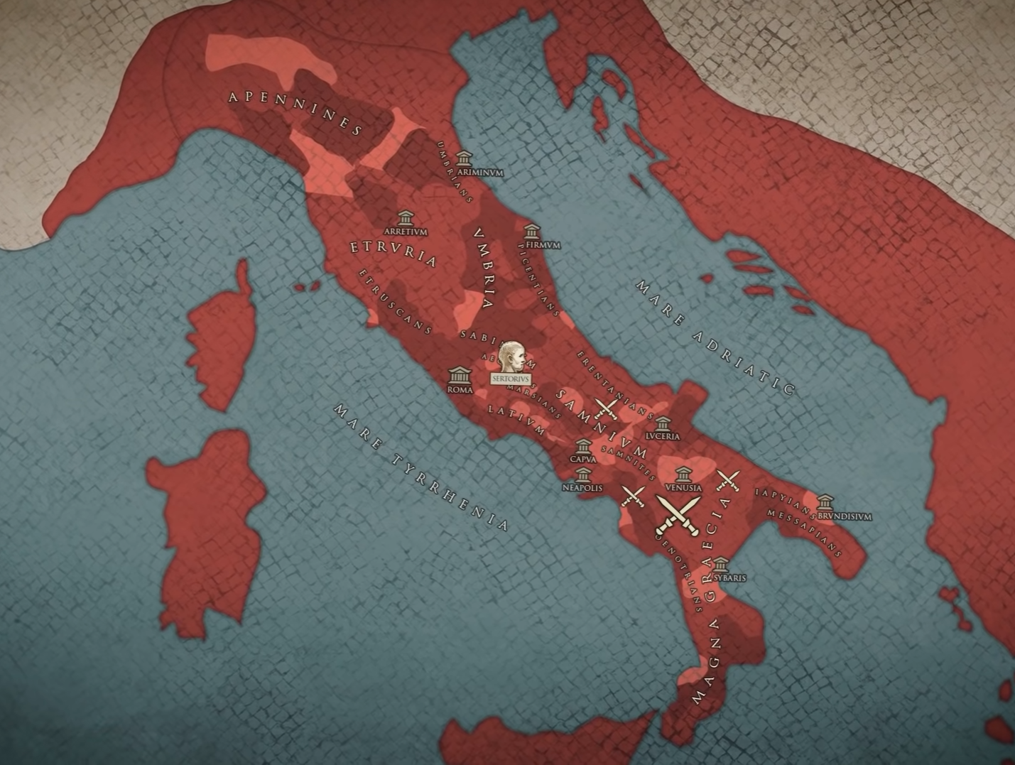
The Social War
GOAL/S: Describe the life and career of Gaius Marius
Week 9, Lesson 1

Slide 2
REVIEW – Where are we up to?
Term/Week | Topic/Content | Assessments
T1 - 1 | Roman Society Overview
T1 - 2 - 3 | Roman Soc/Pol/Eco/Religion/Cul
T1 – 4 - 6 | Tiberius and Gaius Gracchus (133 – 121 BCE) | Essay (Week 6 – 10%)
T1 – 7 - 9 | Gaius Marius (133 – 87 BCE) | Source Analysis (Week 9 – 10%)
T2 – 1 - 2 | Sulla (90 – 78 BCE)
T2 – 3 - 5 | EST | EST (Week 4 – 5 – 15%)
T2 – 5 - 6 | Pompey to 66 BCE | Historical Inquiry (Week 5 – 6 – 10%)
T2 - 7 | EXAMS

Slide 3
The Social War was a civil war fought between the Roman Republic and its Italic client states from 91 to 88 BCE. The Italian tribes demanded Roman citizenship and equal rights because of their cultural and historical ties to Rome and their loyalty to the Republic during its various wars over the past two centuries. Rome refused, leading to its former allies rebelling. The war devastated Italy, and the Roman general Sulla emerged as a popular figure who could even rival the Cimbrian War hero Gaius Marius for power. The war came to an end in 88 BCE when Rome defeated the tribal rebellions, only to grant Roman citizenship to the tribes to prevent another war; the war led to the complete Romanization of the Italian mainland.

Slide 4
Watch the following:
https://www.youtube.com/watch?v=N0oPYaeBiPE&ab_channel=SerapeumHistoria (10min)
Take notes of key words/ideas

Slide 5
Who was involved?
BORN: Arpinum, a small town in Latium, in 157 BCE.
FATHER: a landowner of modest means
MOTHER: came from a wealthy family.
STATUS: equestrian - wealthy aristocrats / well known
At 17 his father died - inherited the family estate.
While he may have been influential in his hometown, Marius was unknown in Rome and when he sought to begin a career in Roman politics, he was considered a novus homo, which means 'new man'.
This meant that he was the first member of his family to serve in the Roman Senate.
Marius married into a wealthy family, which helped him advance his political career.

Slide 6
ACTIVITY - Who was involved?
PERSON/GROUP | DESCRIPTION:
Gaius Marius
Marcus Livius Drusus
Optimates
Marsi and Samnites
Lucius Cornelius Sulla
Gnaeus Pompeius (Pompey Strabo)

Slide 7
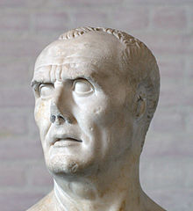
Gaius Marius
Roman general and statesman who was called out of self-imposed exile to lead Rome during the Social War

Slide 8
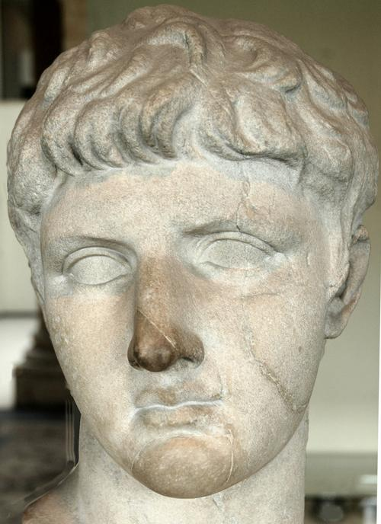
Marcus Livius Drusus
Tribune of the people in the Roman Republic who advocated for Roman citizenship for all Italians and the addition of 300 equites to the Senate.

Slide 9
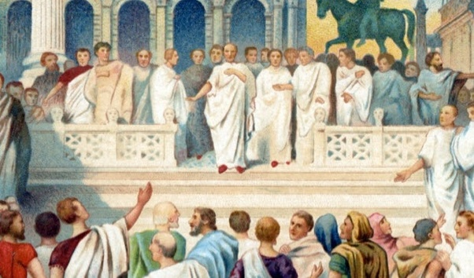
Optimates
The conservative political faction in the Roman Senate who opposed Drusus's reforms and are believed to have orchestrated his assassination.

Slide 10
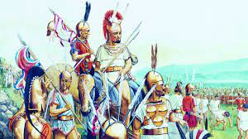
Marsi and Samnites
Two of the Italian tribes that led the revolt against Rome during the Social War.

Slide 11
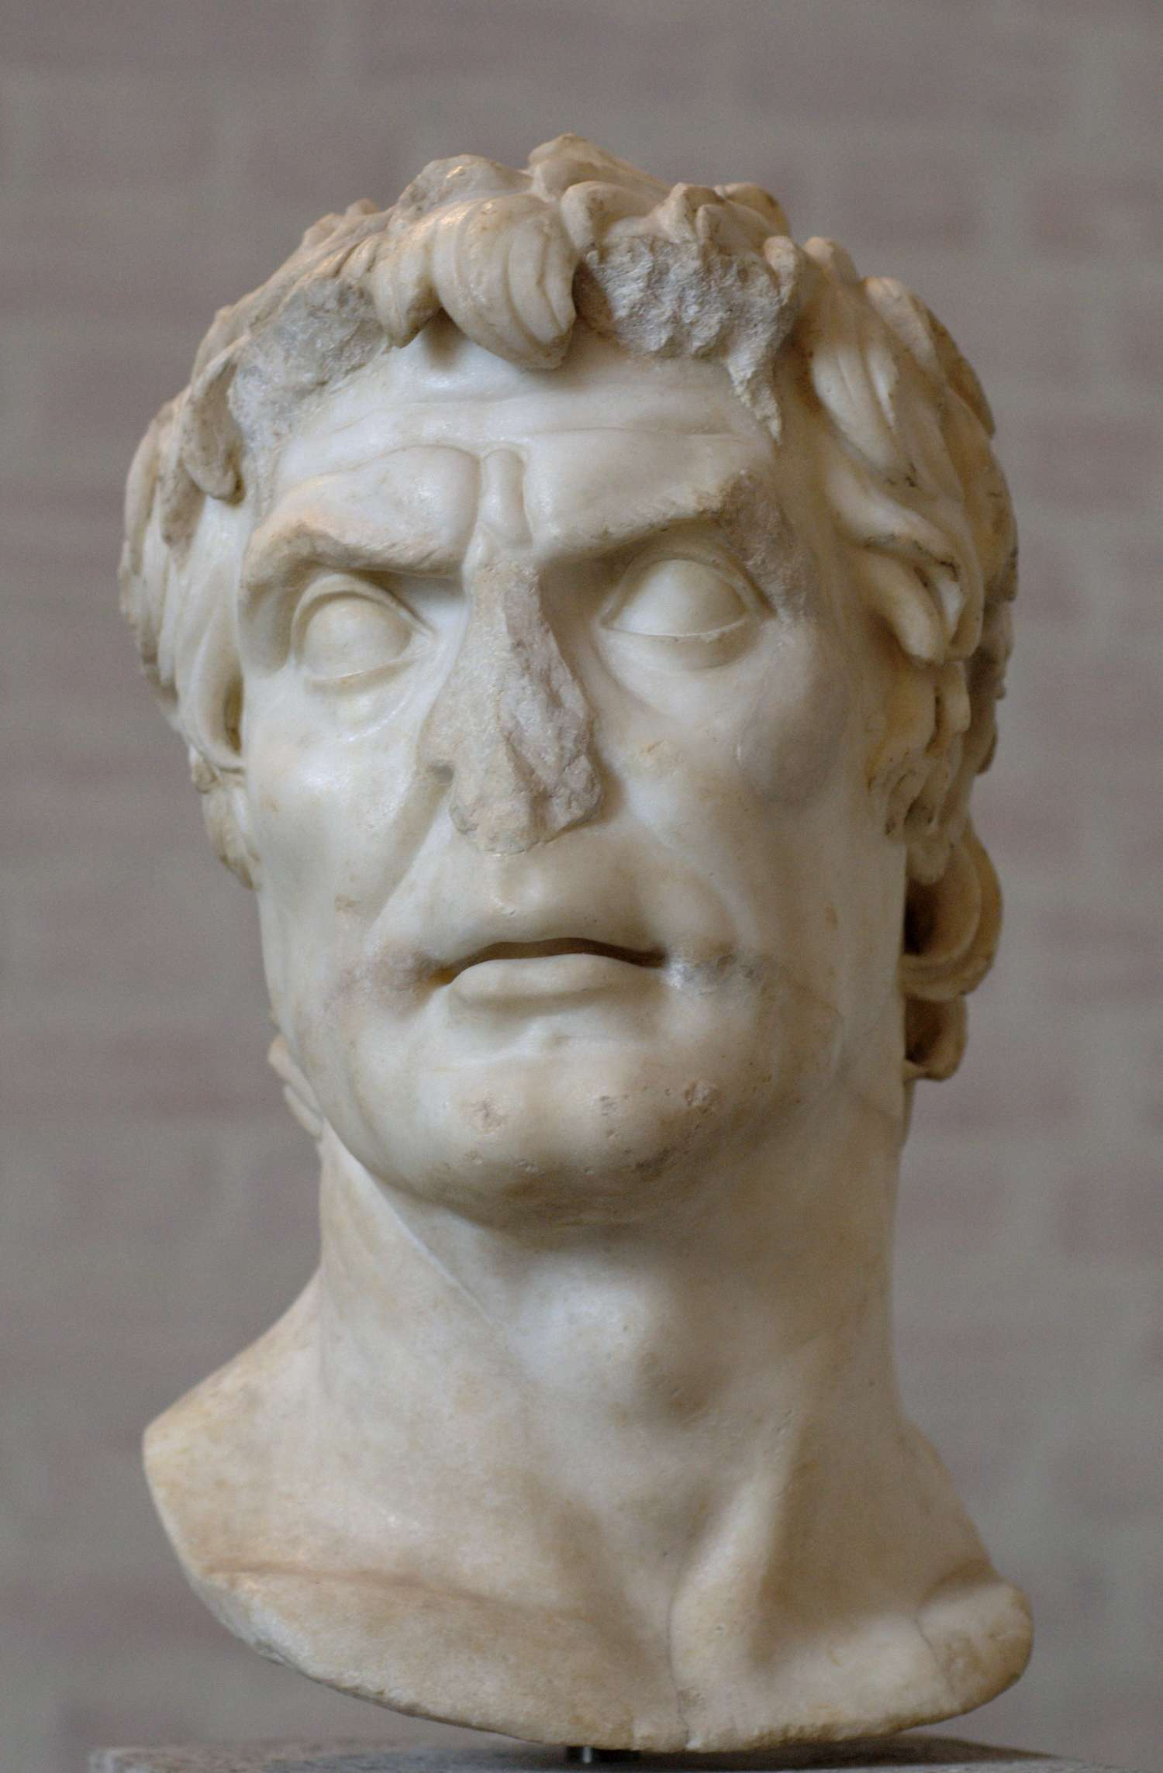
Lucius Cornelius Sulla
Roman general who took control of the southern front of the Social War. Later became consul in 88 BC.

Slide 12
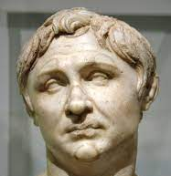
Gnaeus Pompeius (Pompey Strabo)
Roman general who commanded the northern armies during the Social War and father of Pompey the Great.

Slide 13
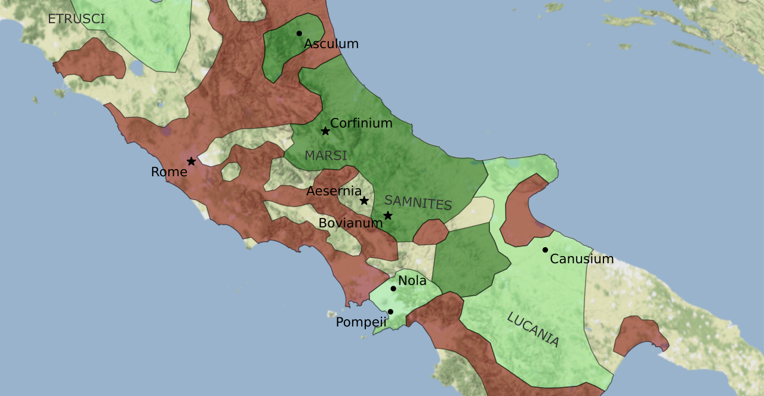

Slide 14
Key Events
Date: | Title of event: | Short description of this event:
99 BCE | Marius's Exile | Marius went into self-imposed exile after losing power.
91 BCE | Start of the Social War | The revolt led by the Marsi and Samnites against Rome began.
90 BCE | Passage of the Lex Julia | This law offered full Roman citizenship to Italians who had not rebelled and those who surrendered their weapons.
88 BCE | Sulla's Consulship | Sulla became consul of Rome due to his military victories in the Social War.

Slide 15
Important Locations
Rome, Italy – centre of the Roman Republic
Corfinium, Italy – Chosen as the rebel capital city during the Social War
Asculum, Italy – Town in northern Italy which was besieged and captured by Pompey

Slide 16
Key words
Tribune of the Plebs:
An official elected by the plebeians (commoners) of Rome to represent their interests in the Roman government.
Roman Citizenship:
Granted a range of rights and protections under Roman law, including the right to vote. Was extended to more Italians as a result of the Social War.
Mithridatic Wars:
A series of three wars fought by Rome against the Kingdom of Pontus and its ally Armenia, which were sparked in part by the Social War.

Slide 17
Summary Example:
The Social War was mainly caused by the discontent of Rome's Italian allies over the lack of political rights, especially their lack of Roman citizenship. These allies had long contributed men and resources to Rome's wars, but were not given the rights and privileges of full Roman citizens. The assassination of the tribune Marcus Livius Drusus, who had proposed reforms to address these issues, sparked the armed revolt. The war was resolved through a combination of military campaigns and political concessions. The Lex Julia, passed in 90 BCE, offered Roman citizenship to those who had not rebelled and those who would lay down their arms. Gradually, with the combination of Roman military victories and these political concessions, the revolt was quelled and the Italians integrated into the Roman political system.

Slide 18
ACTIVITY – Summary of the Social Wars
Write a one-paragraph summary of the Social Wars. You must include the following:
cause/s
key people/groups
location
key date/s
key words

